Slide 1

hapPyness
a group project by aashita, alannah, ben & brian

Slide 2

“Happiness is a warm puppy” - Charles Schulz

Slide 3

“Happiness is a state of mind” -Walt Disney

Slide 4



“A person needs just three things to be truly happy in this world: someone to love, something to do, and something to hope for.” -Tom Bodett

Slide 5






The World Happiness Report - Data Set
Notes:
The analysis is based on the World Happiness Report from 2016-2020, looking at the happiness score of 155 countries as well as the importance of the six factors of happiness in determining overall happiness in each country. The report continues to gain global recognition as governments, organizations and civil society increasingly use happiness indicators to inform their policy-making decisions. The happiness scores and rankings use data from the Gallup World Poll. The scores are based on answers to the main life evaluation question asked in the poll.
The following columns: GDP per Capita, Social Support , Health/Life Expectancy, Freedom to make Choices, Generosity, Perceptions of Govt. Corruption describe the extent to which these factors contribute in evaluating the happiness in each country.
The four datasets used in this analysis are available on Kaggle.

Slide 6
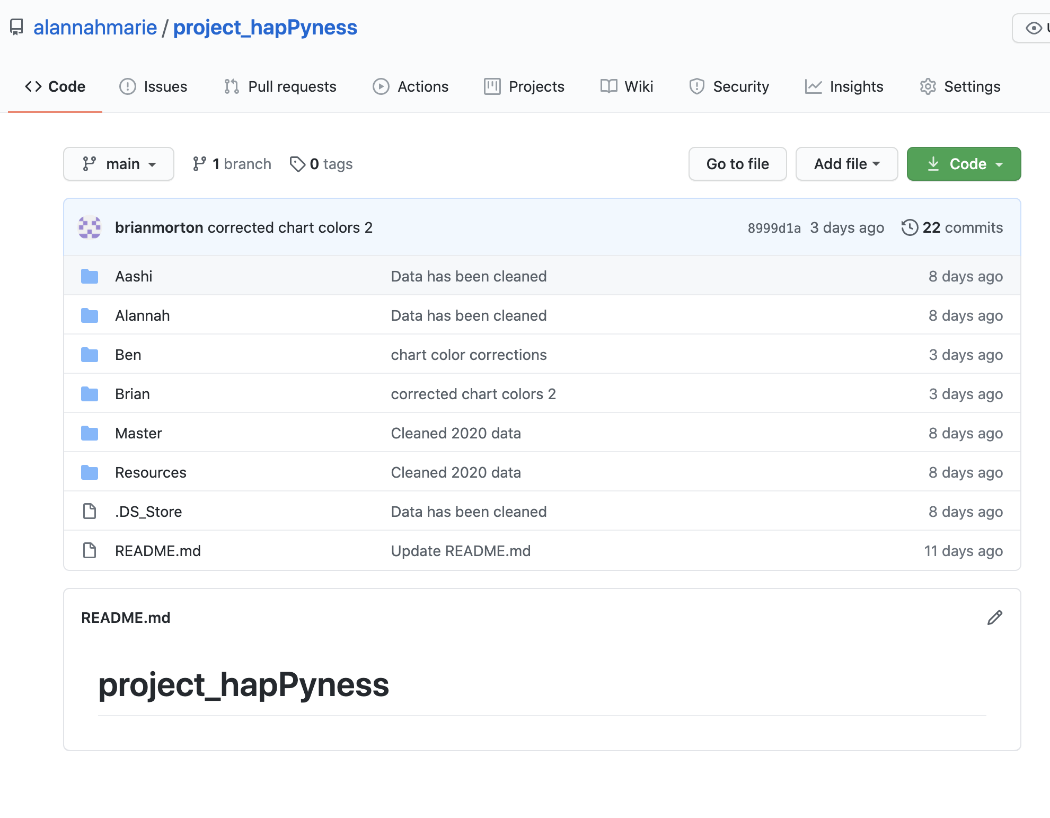
Dividing the Work

Slide 7
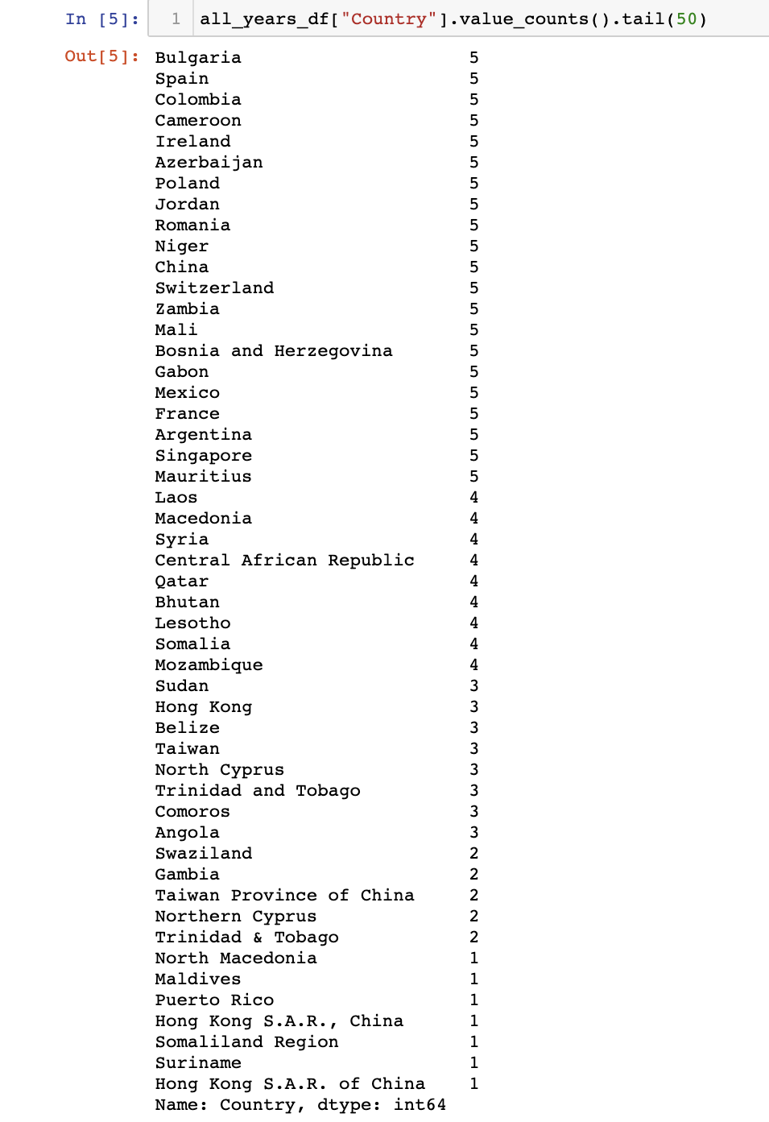
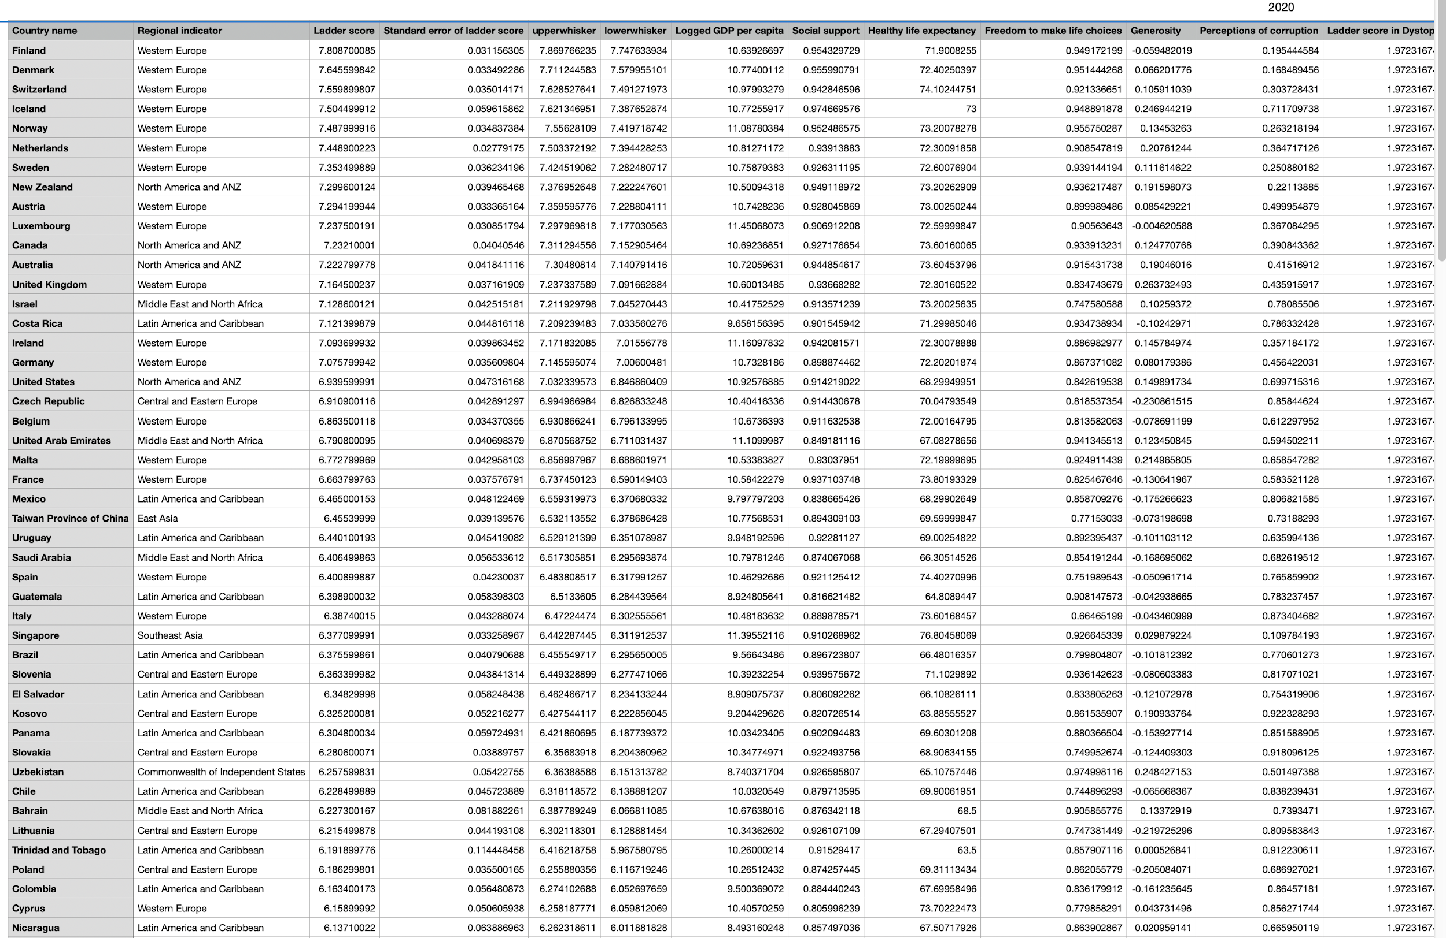
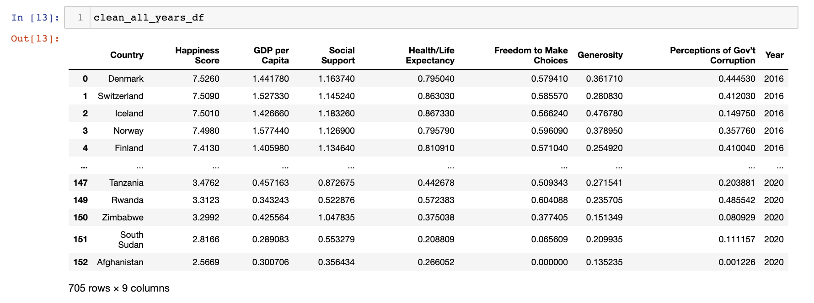
Cleaning the Data
Notes:
Data Cleaning
We had data for 2016 - 2020
Data for each year had varied levels of information, such as statistical analyses of the metrics used to determine happiness score. However, as a group, we decided it would be best to pare the data down and focus solely on the 6 metrics used to determine the happiness score and the happiness score itself.
Each of us took one year’s data (except for Aashi, who cleaned two!) and dropped the columns we deemed unnecessary. We also prescribed column names and order so that the cleaned data could be merged into one large dataframe, seamlessly.
We then noticed that not all of the countries in the data appeared over all 5 years, so we decided to drop the data for those countries altogether. This, we worked on together and discovered the best way to remove these from the data.
We then saved all of the cleaned datasets into CSVs for each year and one that had the data for all years. We read these into a jupyter notebook, that became the starter book for each of us to work from.
We also set guidelines for our visualizations so that our final project would be clear and consistent.

Slide 8

Are wealthier countries happier countries?

Slide 9
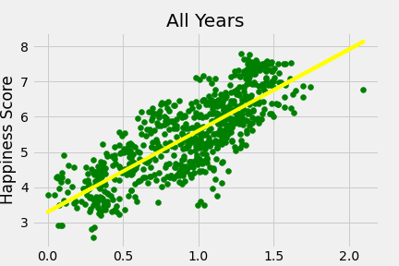
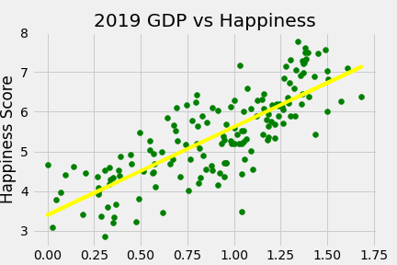
Mo money ≠ Mo problems
Across all years measured 2016-2020 as well as individual years their is a strong statistical correlation

Slide 10
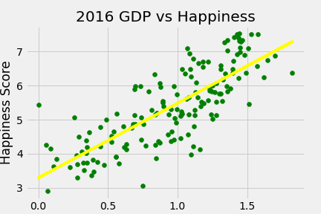
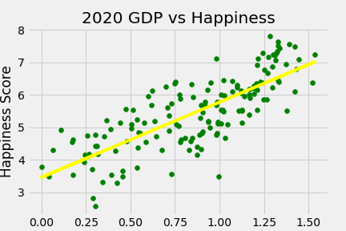
2020 vs
Everyone
Out of all years measured 2020 was the lowest as part of a broader trend toward slightly decreasing happiness over time and a slightly decreasing correlation (still a strong statistical correlation)

Slide 11

Are the healthiest countries the countries with the most freedom?

Slide 12
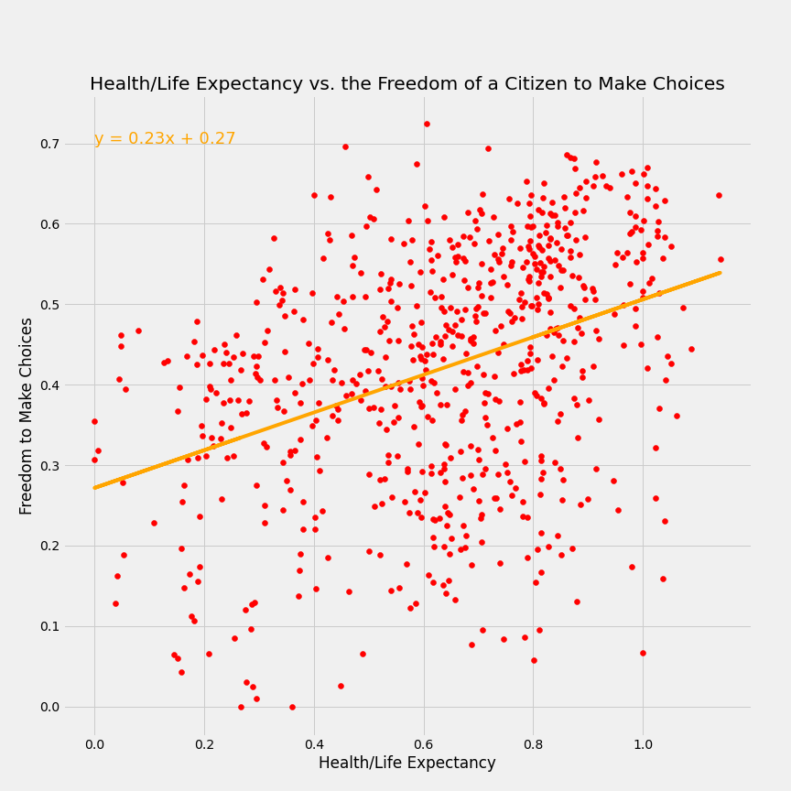

Slide 13
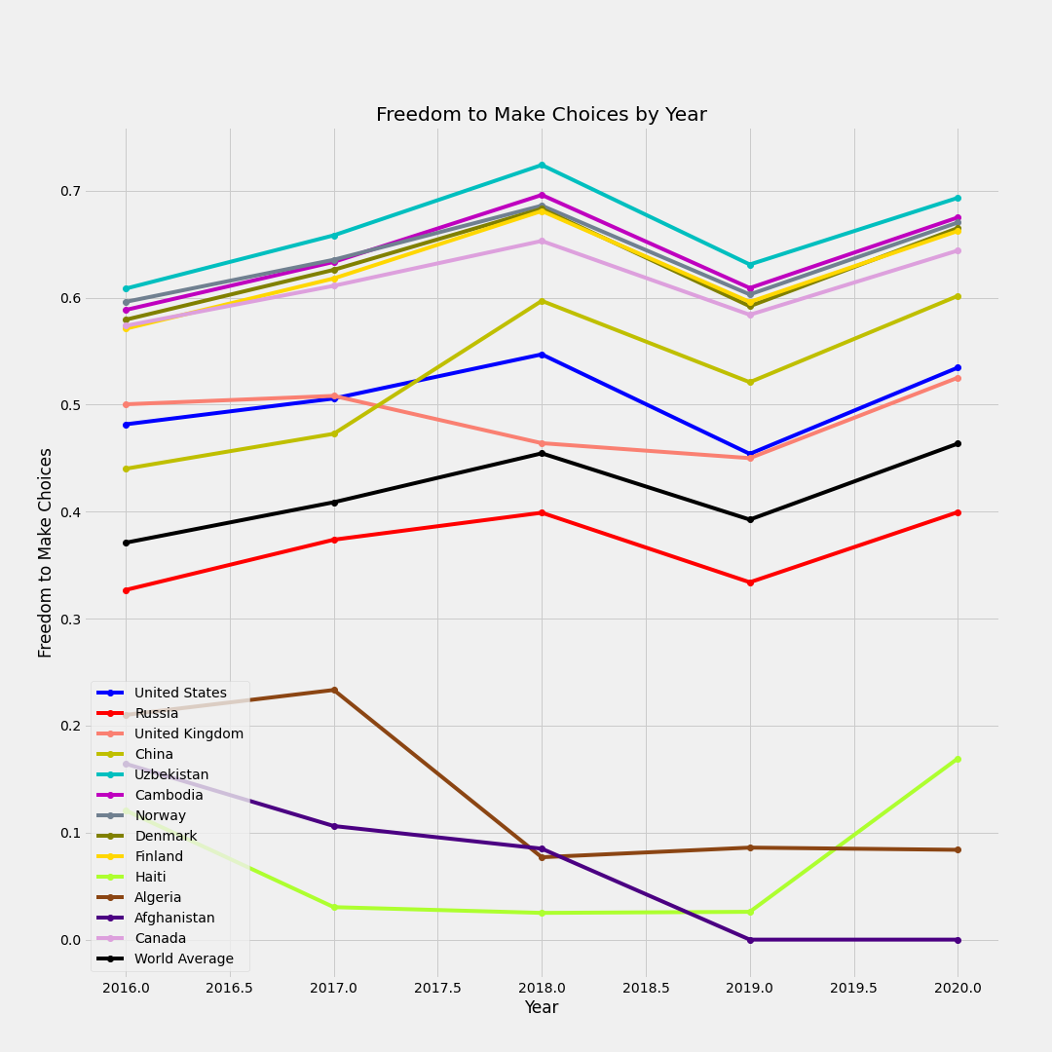

Slide 14



Slide 15
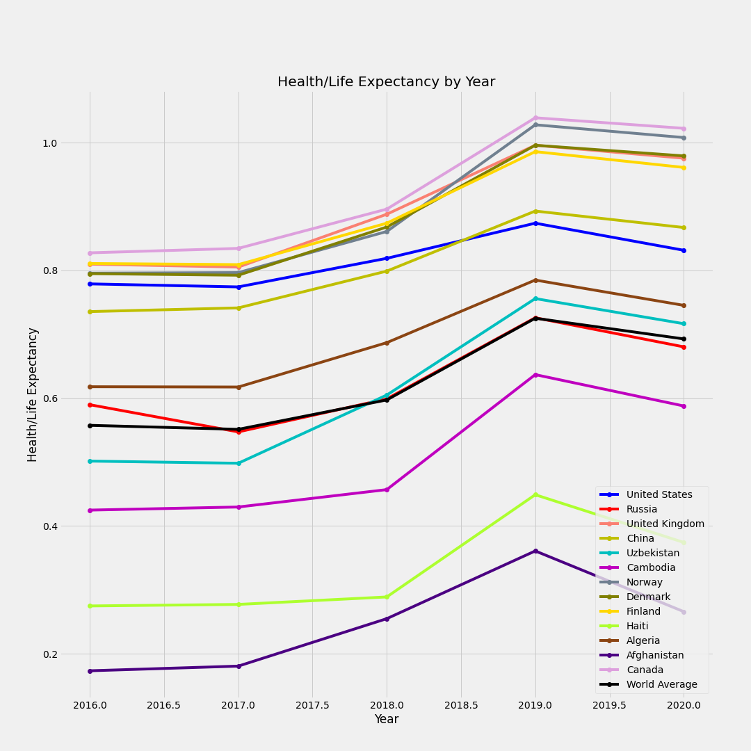

Slide 16

How can our President promote the wellbeing of his citizenry ?

Slide 17
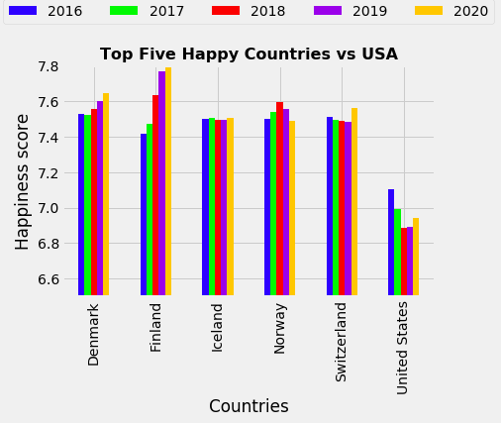
What America can learn from world’s happiest countries?

Slide 18
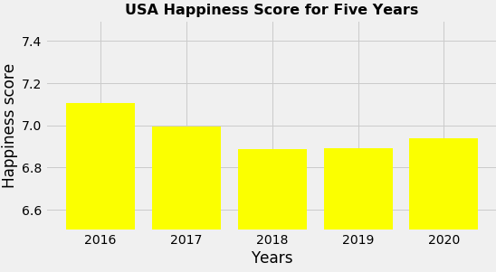
The United States is the Unhappiest It’s Ever Been!
U.S. dropped to No.19 in 2019 ,its worst ranking ever

Slide 19
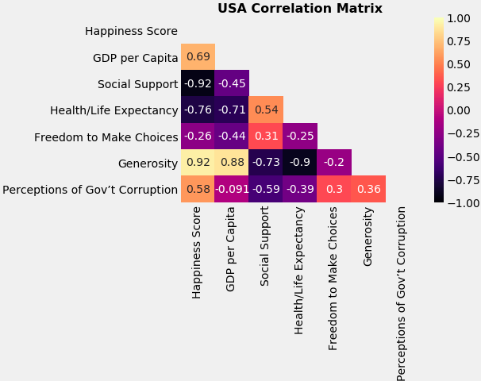
Let’s Take A Closer Look!

Slide 20
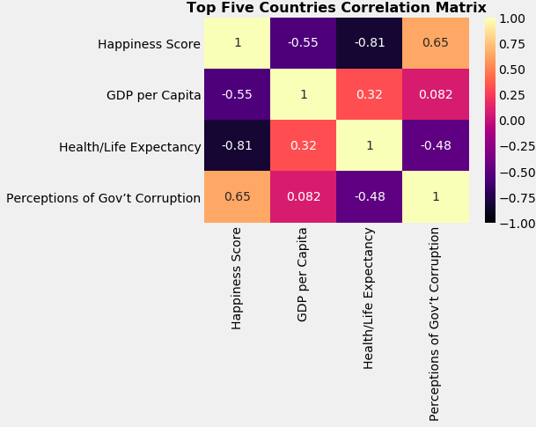
Changes in which metrics can improve US Score?

Slide 21
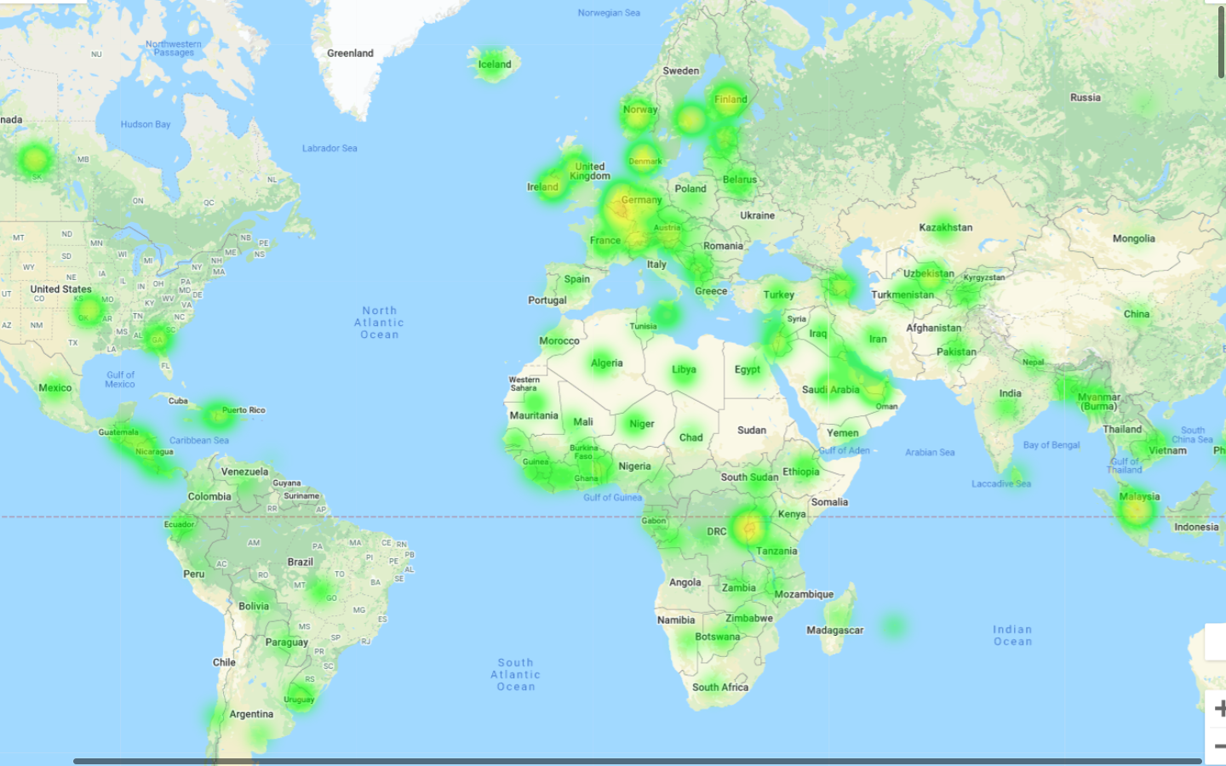
Political Integrity = Happy Nations
Government Corruption World map from 2016-2020

Slide 22
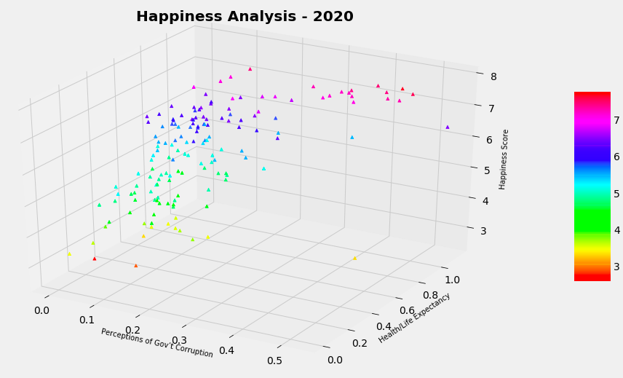
"The essence of good government is trust.” - Kathleen Sebelius

Slide 23


Slide 24
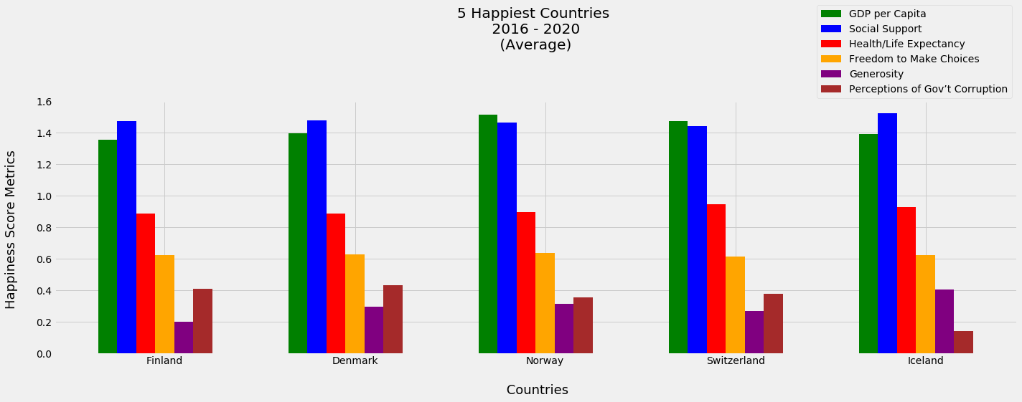
Is there a formula to happiness?

Slide 25
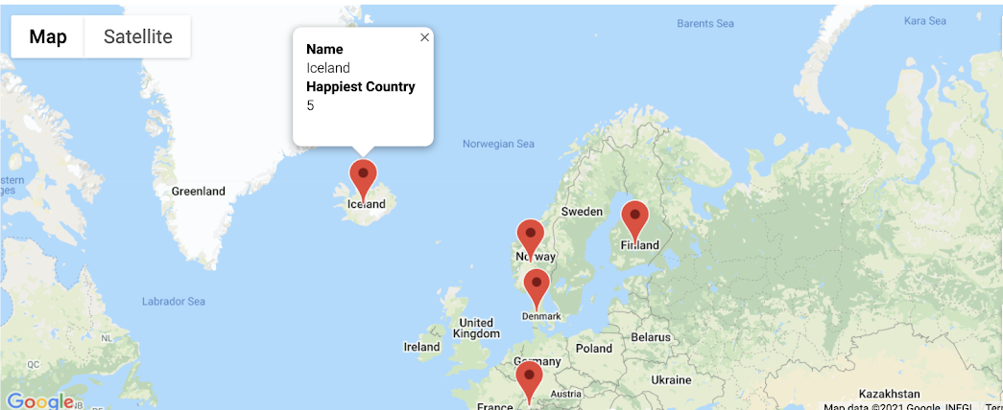
What’s geography got to do with it?

Slide 26
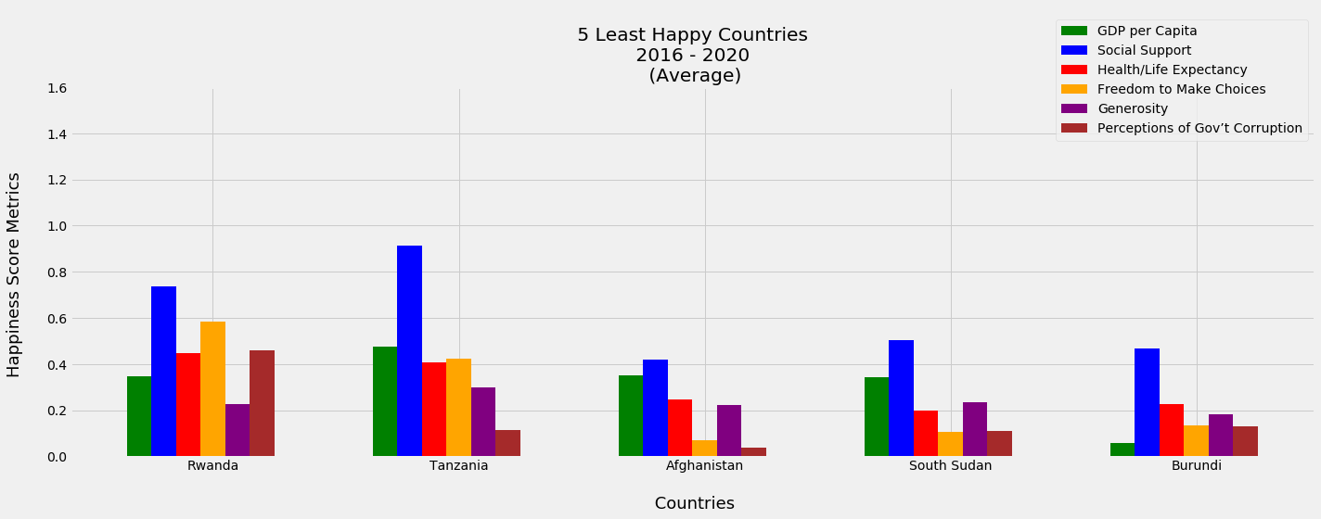
Can the same be said for unhappiness?

Slide 27
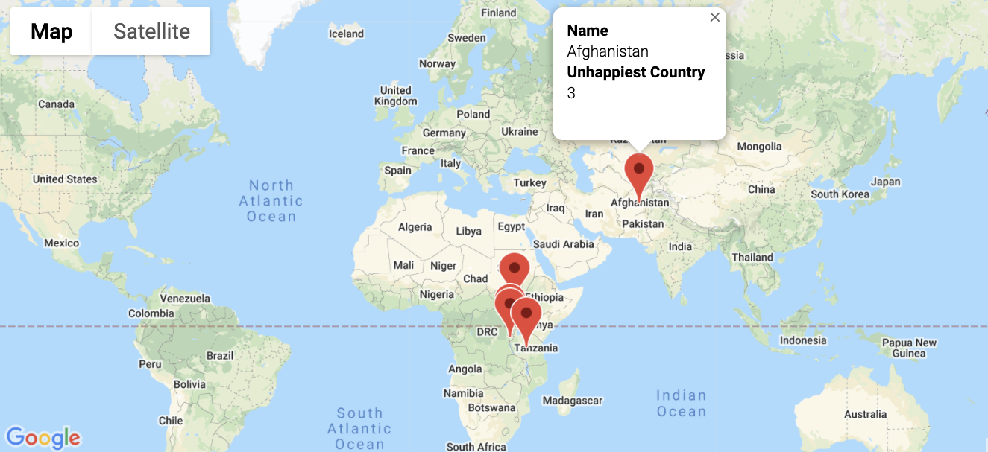
What’s geography got to do with it?

Slide 28
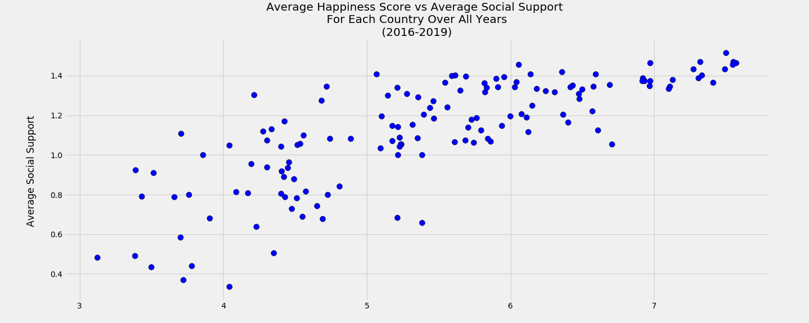
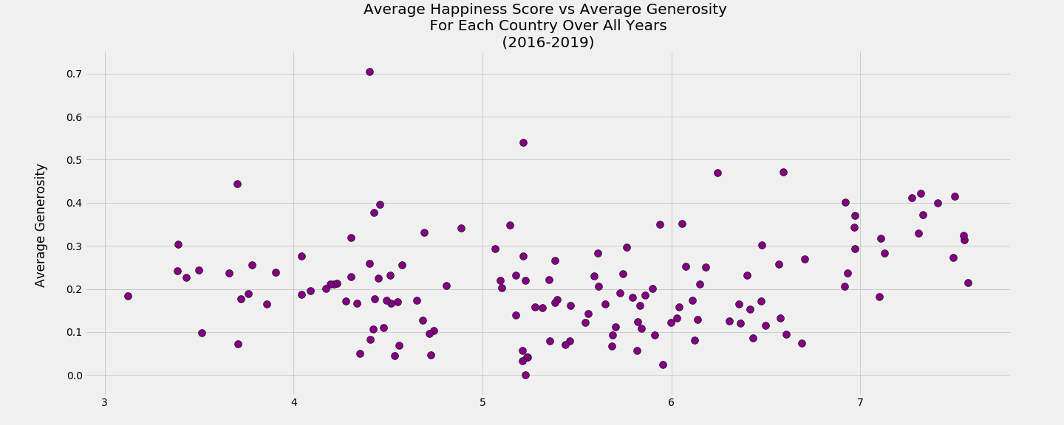
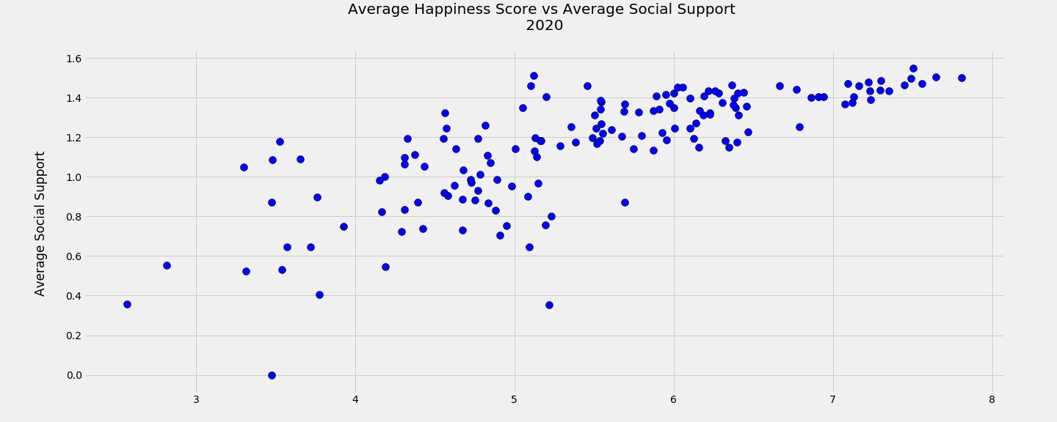
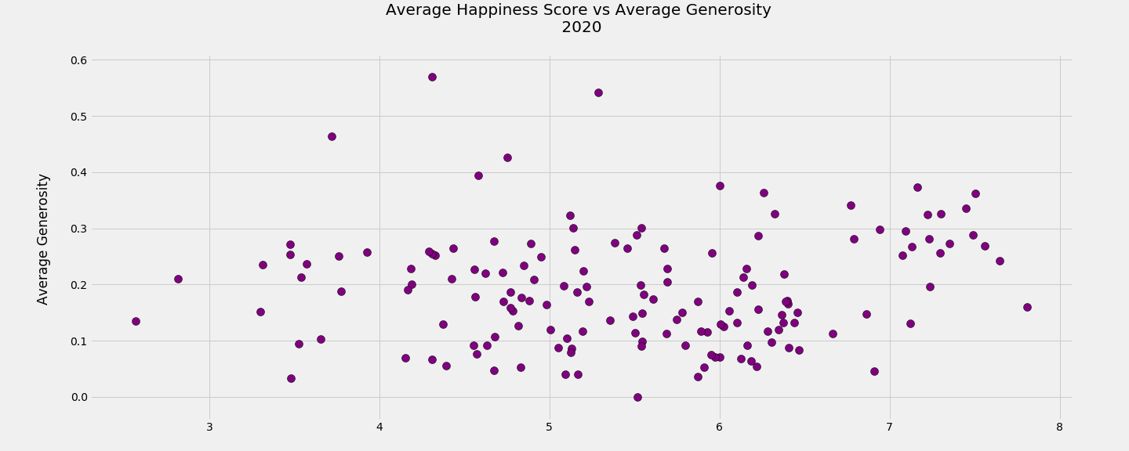
2020????

Slide 29
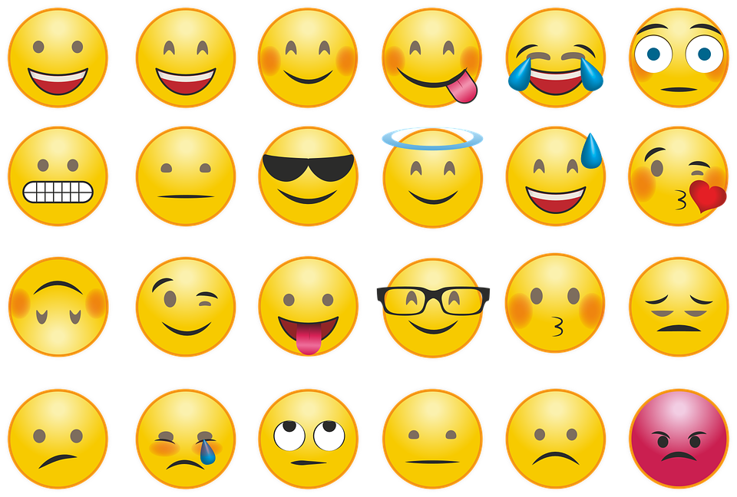
QUESTIONS?

